Slide 1
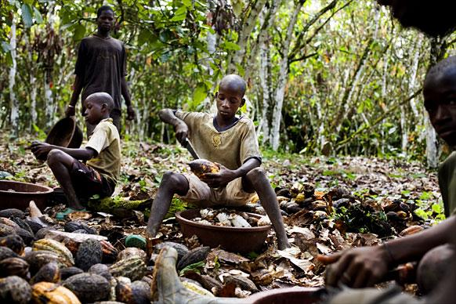
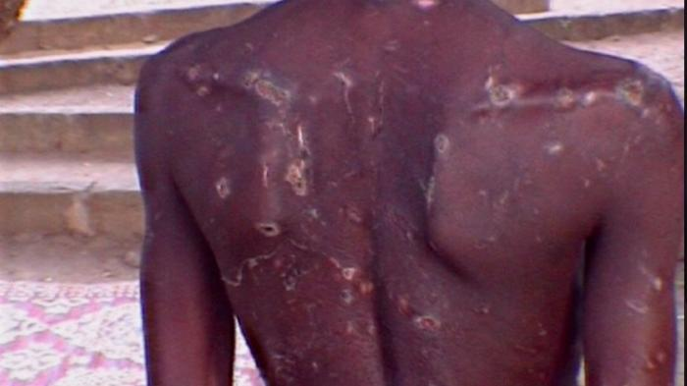
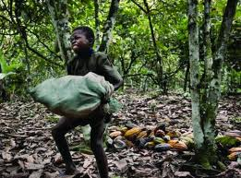
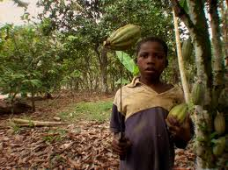
Cocoa and Child Labor
Notes:
What these documentaries found and what reporters uncovered was extensive use of child and forced labor on West African Cocoa farms. A Boy was beaten after attempting to run away from the cacao farm where he’d been working as a slave. These Children, instead of going to school, are working with machetes and undertaking back-breaking work.

Slide 2
Worst Forms of Child Labor ILO Convention No. 182:
All forms of slavery or practices similar to slavery
The use, procuring or offering of a child for prostitution or pornography
The use, procuring or offering of a child for illicit activities
Work which is likely to harm the health, safety or morals of children.

Slide 3
Forms of Child Labor (example from Kuapa Kokoo)
Key Hazards in Cocoa
Permissible Child Work
Help with cooking, serving food, childcare
Running errands on the farm
Filling nursery bags with black soil
Watering and planting seedlings
Weeding, with age-appropriate cutlass
Fetching water for spraying and leaving the farm before spraying commences
Gathering plucked cocoa pods
Carrying small loads
Breaking cocoa pods with a mallet or hitting it on the ground
Plucking pods within the reach of the hand
Scooping and removal of beans from broken Pods
Felling trees, burning and slashing
Carrying heavy loads, more than 30% of body weight, over a distance of more than 2 miles
Prolonged awkward postures
Falling from a height, slips and falls
Use of inadequate tools and equipment, including sharp implements
Purchase, transport, mixing, spraying, storage and disposal of chemicals
Working long duration, i.e. more than 6 hours per day

Slide 4
How widespread is the problem?
From a 2008 survey. . .
In Cote d’Ivoire,
53.2% of children carried heavy loads,
8.4% sprayed fertilizers,
5.5% cut trees,
4.6% sprayed pesticides (and 35% were indirectly involved).
66% of children on cocoa farms do not attend school
In Ghana,
46.7 % took part in at least one hazardous cocoa activity
23.2% used protective clothing while working on the farm

Slide 5
Key Action Plan Harkin-Engel Protocol, 2001
Publicly acknowledge forced child labor
Commit significant resources
Form an international foundation to advise on best practice
Develop and implement, by 2005 a “credible, mutually-acceptable, voluntary, industry-wide standards of public certification”
Notes:
Publicly acknowledge forced child labor in West Africa
Commit and continue to commit significant resources to address the problem
Form an international foundation – a non-profit, funded by the industry, and including non-govermental organizations to advise on best practice to avoid the WFCL
Develop and implement, by 2005, a credible, mutually acceptible, voluntary, industry-wide standards of public certification that they have been produced without the Worst Forms of Child Labor.

Slide 6
Since the Harkin-Engel Protocol
2005: A certification system will cover 50% of the cocoa growing areas of Côte d’Ivoire and Ghana by 2008
2006: US Department of Labor commissions Tulane University to serve as an oversight body
2008: Independent verification was not in place, and the deadline for certification extended until 2010
2010: Joint Declaration and Framework for Action signed
Notes:
2005: The industry had not implemented a certification system. The industry promised Rep Engel and Sen Harkin that they would have a certification system in place within 3 years
2010: By 2020, the worst forms of child labor as defined by ILO Convention 182 in the cocoa sectors of Côte d’Ivoire and Ghana will be reduced by 70 percent in aggregate through joint efforts
Over the past decade, the industry has spent more than $75 million on activities related to the reduction of the worst forms of child labor in Cote d’Ivoire and Ghana, including $18 million for the International Cocoa Initiative, the foundation set up under the Protocol. Industry has also committed $7 million to further the goals of the Framework of Action. This industry partnership includes the participation of ADM, Barry Callebaut, Cargill, Ferrero, The Hershey Company, Kraft Foods, Mars Incorporated, and Nestlé. (From responsiblecocoa.com)

Slide 7
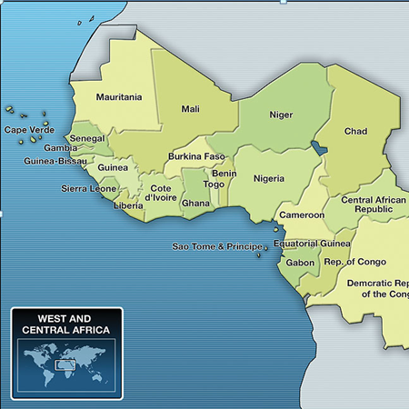
Violation of International Labor Standards
US Dept. of Labor
2010
Notes:
70% of the world’s cocoa comes from West Africa from nearly 2 million cocoa farmers
In 2010, The US Department of Labor reported that cocoa from 5 countries was likely produced with labor in violation of international standards:
Ivory Coast - Child labor, forced labor
Ghana - Child labor
Cameroon - Child labor
Nigeria - Child labor, forced labor
Guinea - Child labor

Slide 8
Fair Trade is. . .
“a trading partnership, based on dialogue, transparency and respect, that seeks greater equity in international trade. It contributes to sustainable development by offering better trading conditions to, and securing the rights of,
marginalized producers and workers – especially in the South.”
Notes:
FINE was created in 1998 and is an informal association of the four main fair trade networks:
F Fairtrade Labelling Organizations International (FLO)
I International Fair Trade Association, now the World Fair Trade Organization (WFTO)
N Network of European Worldshops (NEWS!) and
E European Fair Trade Association (EFTA)
8

Slide 9
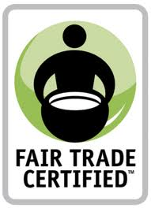
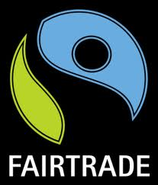
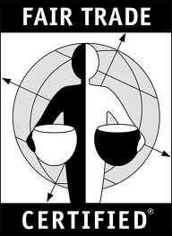
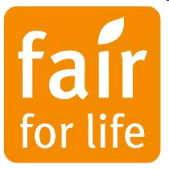
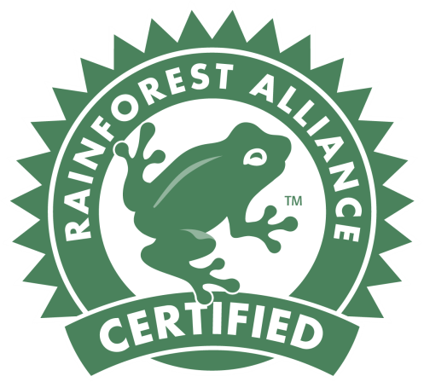
Certifications
Notes:
Fair Trade ensures:
Payment of a Fair Price
More direct and long-term trade relationships
Democratic and Transparent cooperatives
Funds for community development projects
Training programs and technical assistance for farmers
Strictly prohibits the use of child and forced labor
UTZ Certified and Rainforest Alliance are not “Fair Trade” but do have some standards for environmental sustainability.
Neither of these guarantees any of the listed items above (NO social premium, guarantee only a min wage- as defined by national laws, and no pre-financing
More about better Farm Management – which leads to better yields – and more money, though NOT necessarily going to workers.
Rainforest Alliance allows the seal to be used as long as 30% of the product is sourced from them.

Slide 10
Hershey’s: 100% Certified by 2020
Rainforest Certification for Dagoba Organic line
The rest to be certified by 2020
Programs to help farmers increase yields
Unintended consequences?
Investing $10 million over five years to reduce child labor and improve cocoa supply
CEO made $10.6 million in 2011
Company made $6 billion in 2011
October 2012
Notes:
Using Rainforest Certification for Dagoba Organic line, will expand it to the Bliss line. (That’s only 1%!)
Programs to “help farmers” may have unintended consequences
Belief that West African farms are largely unproductive – not good businesses, not efficient
Idea is to increase yields – make more money – thus less need for child labor
Backfire – higher yields might also lead to lower prices for cocoa – making them worse off.
Oh – and lower prices means that Hershey’s can buy the chocolate at a lower price – making them MORE profit!! (Some evidence that they did this in Belize in the 1980s)

Slide 11
Other Recent Announcements
Green & Black’s shifts to 100% Fair Trade (announced 2010)
Ben & Jerry’s shifts to 100% Fair Trade ingredients by 2013 (ann. 2010)
Bon Apetit uses Fair Trade cocoa in US kitchens (announced 2011)
Barry Callebaut $41 million sustainability intiative over 10 years (announced 2012)
Blommer Chocolate Company invests $45 million by 2020
Nestlé invests $110 million over 10 years (announced 2009)
To improve quality, sustainability and farmer livelihoods
Notes:
Some info from Elizabeth O’Connell’s FT Presentation
(Some data from United Methodist Women)

