Slide 1
Representative Eliot Engel
Speaks at Manhattan College

Slide 2
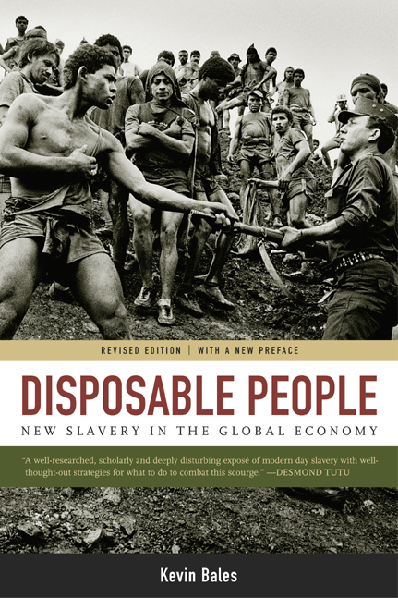
“New Slavery in the Global Economy”
Book, 1999
Notes:
A Pulitzer- Prize nominated book, Kevin Bales wrote “Disposable People” in 1999. By investigating “New Slavery” in countries throughout the world, he argues that its modern day presence is linked to the global economy. Modern day slavery is not a long-term investment but a cheap way to produce the goods that we want.

Slide 3
“Slavery: A Global Investigation”
Film, 2000
Notes:
Inspired by the book Disposable People, True Vision of London produced an 80-minute documentary. In “Slavery: A Global Investigation”, the filmmakers actually buy slaves in Africa and helped to free child slaves in India and clearly exposes slavery in the cocoa plantations in the Ivory Coast.

Slide 4
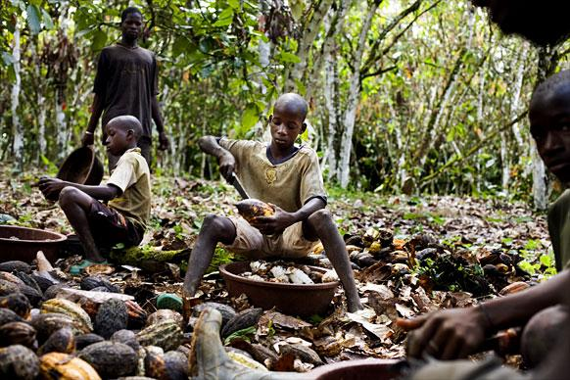
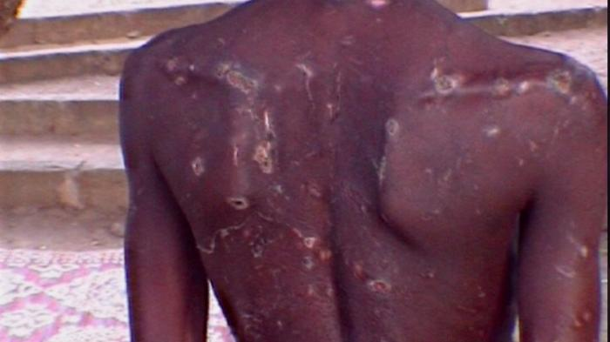
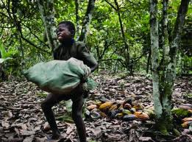
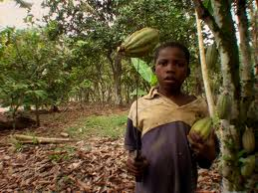
Child and Slave Labor
Notes:
What these documentaries found and what reporters uncovered was extensive use of child and forced labor on West African Cocoa farms. A Boy was beaten after attempting to run away from the cacao farm where he’d been working as a slave. These Children, instead of going to school, are working with machetes and undertaking back-breaking work.

Slide 5
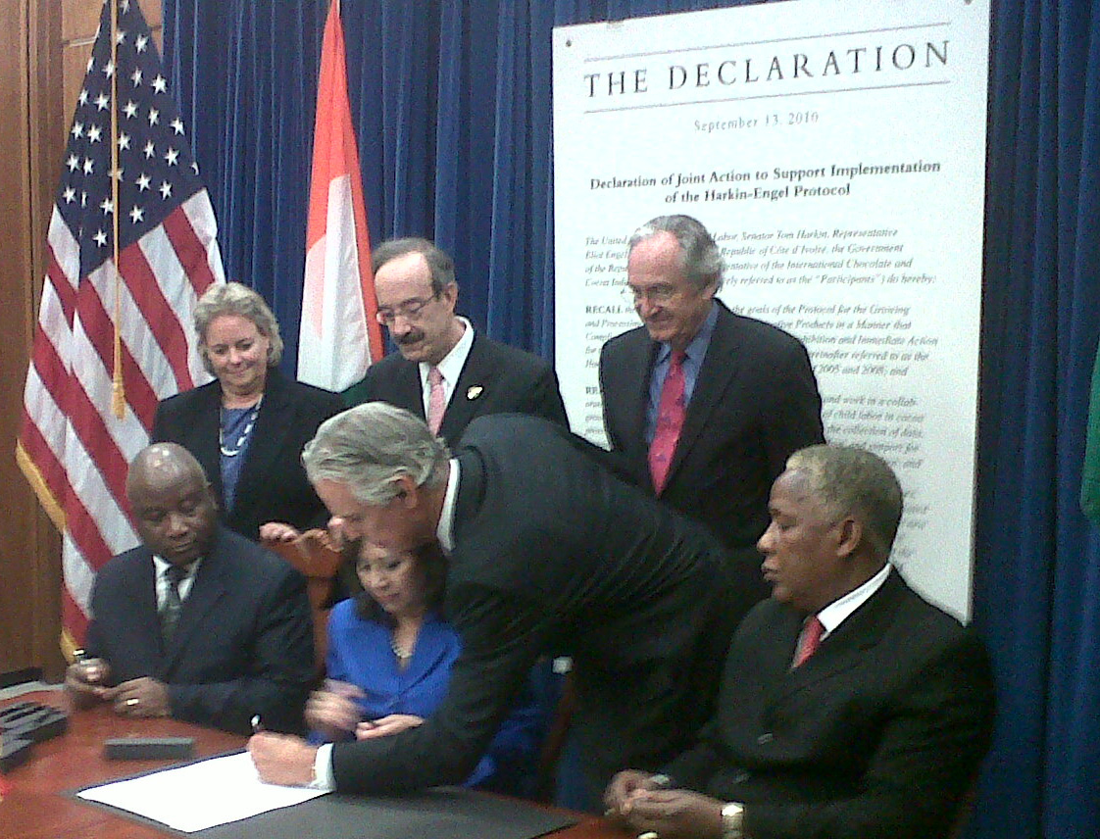
Harkin Engel Protocol
2001
Notes:
These reports sparked a movement. Congress passed a rider to the agricultural appropriations bill in the House of Representatives that created a labeling system for chocolate – classifying cocoa as “slave free” if it could be documented that its production hadn’t involved the work of exploited children.
As a result, a partnership was formed--the first time that a US industry voluntarily agreed to regulation.
The Harkin-Engel Protocol was signed by Rep. Engel and Senator Tom Harkin of Iowa, the U.S. Department of Labor, the governments of Ghana and Cote d’Ivoire, and the international cocoa industry . . .

Slide 6
Key Action Plan Harkin-Engel Protocol, 2001
Publicly acknowledge forced child labor
Commit significant resources
Form an international foundation to advise on best practice
Develop and implement, by 2005 a “credible, mutually-acceptable, voluntary, industry-wide standards of public certification”
Notes:
The Key actions of the Harkin Engel Protocol included
Public acknowledgement by the cocoa industry that child and forced labor was a problem in West Africa
The industry had to Commit significant resources to address the problem
They Formed an international foundation – a non-profit, funded by the industry, and including non-govermental organizations to advise on best practice to avoid the WFCL
Develop and implement, by 2005, a credible, mutually acceptible, voluntary, industry-wide standards of public certification that the cocoa had been produced without the Worst Forms of Child Labor.

Slide 7
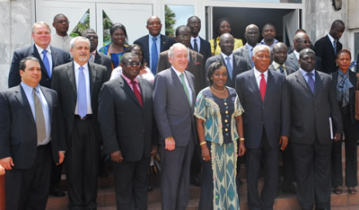
Progress
$75 Million
Notes:
The industry has spent more than $75 million in the last decade on activities related to the reduction of the worst forms of child labor in Cote d’Ivoire and Ghana, Including $18 million for the International Cocoa Initiative –a foundation to advise the industry on eliminating child labor
These Public Private Partnerships between the Government (US, Ghana and Cote D’Ivore) and the cocoa industry led to many meetings and frank discussions
And in 2006: US Department of Labor commissions Tulane University to serve as an oversight body

Slide 8
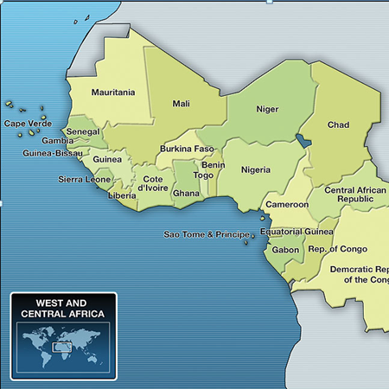
Violation of International Labor Standards
US Dept. of Labor
2010
Notes:
However more action is needed!
In 2010, The US Department of Labor reported that cocoa from 5 countries was likely produced with labor in violation of international standards:
Ivory Coast - Child labor, forced labor
Ghana - Child labor
Cameroon - Child labor
Nigeria - Child labor, forced labor
Guinea - Child labor

Slide 9
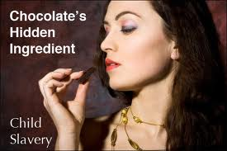
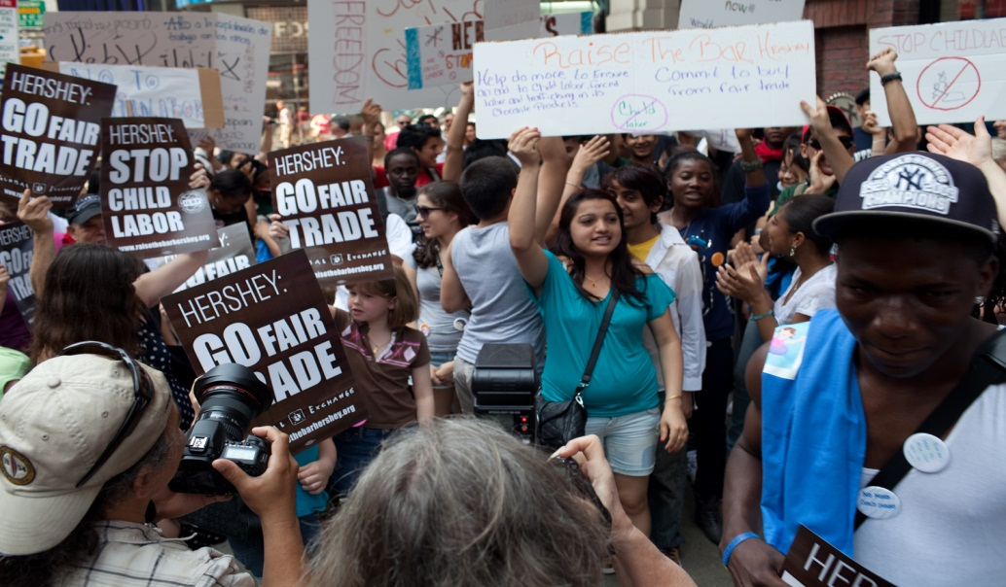
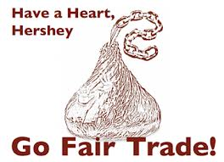
Our Purchases Make a Difference
Notes:
As consumers – what WE ask for DOES matter. Educated and concerned citizens have encouraged companies to clear their supply chains of child and forced labor.
In Fall 2012 semester, almost 600 Fair Trade chocolate bars were purchased at the bookstore and retail dining outlets.
That’s 2100 ounces, or 131 pounds, or 59 kilograms

Slide 10
“Never doubt that a small group of thoughtful, committed citizens can change the world. Indeed, it is the only thing that ever has.”
Margaret Mead
Notes:
Whether it is through government, a company’s own group for Social Responsbility, or through our own collective actions as consumers, we are the ones who can affect change.

Slide 11
Representative Eliot Engel
New York 16th Congressional District

